Slide 1
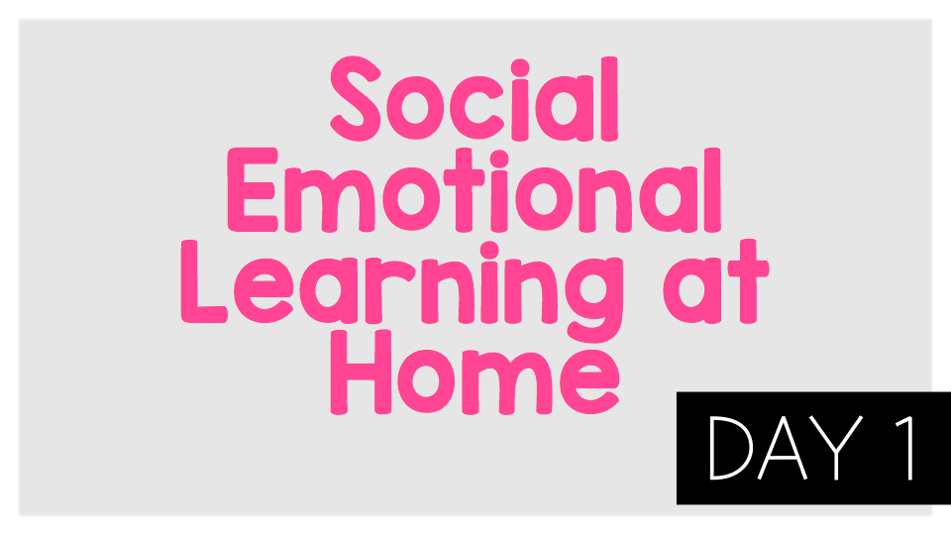
©TheSocialEmotionalTeacher

Slide 2

Think:
What are the differences between everyday feelings and overwhelming feelings?
What are some self-care strategies that we can use to deal with everyday feelings, what does Sasha do? does it work?
How are the feelings that André is experiencing different? What does André do to manage these feelings?
What advice does André get from Sasha and his Head of Year?What are some other things André could do?
What can you do if you are worried about a friend?

Slide 3
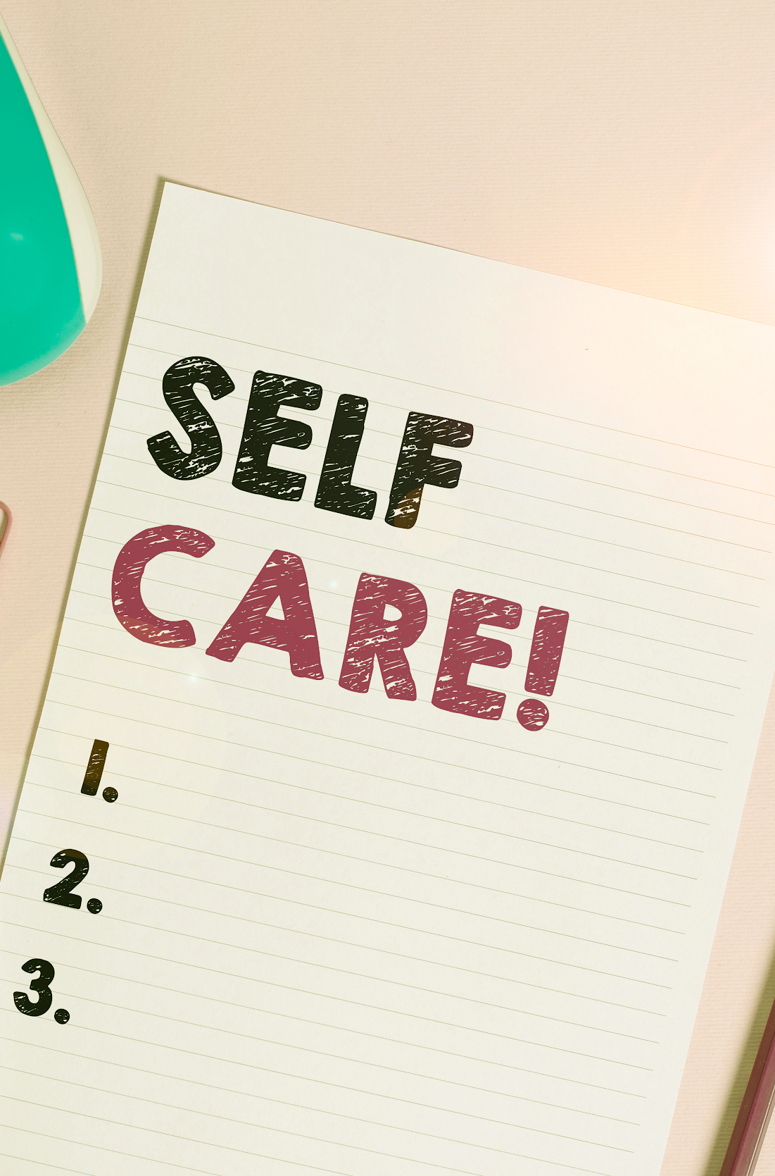
Activity:
As we saw in the video, we all have mental health and we need to take care of our mental health in the same way that we take care of our physical health. What are some of the ways we can take care of our mental health? We call this self-care. Choose one of these self-care strategies to practice now:
Writing
Read a book
Art
Sports or exercise
Playing with a pet
Relaxing
Eating a healthy snack and drinking water
Listening to uplifting music
Talk to a friend or family member

Slide 4
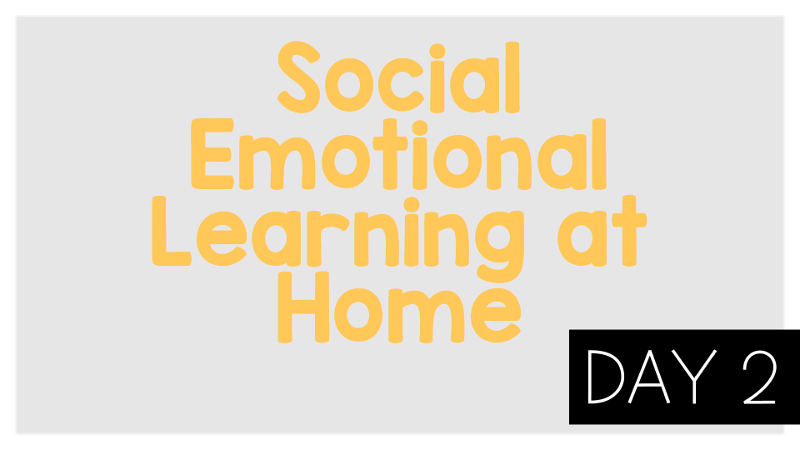
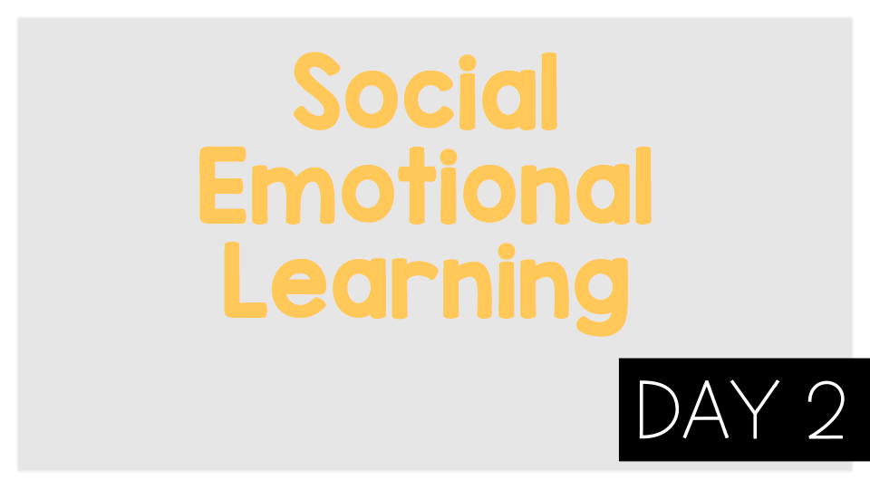
©TheSocialEmotionalTeacher

Slide 5
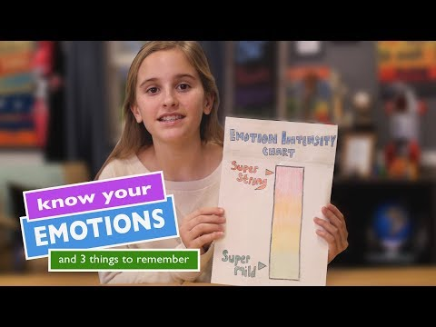
Think:
What emotion or emotions are you feeling right now?
How can you measure your emotions?
Do emotions change or stay the same?
“There are no good or bad emotions.” Do you agree or disagree? Why?

Slide 6
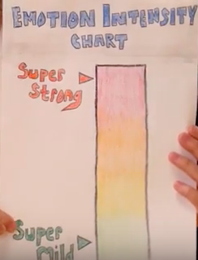
Activity:
Draw your own emotion intensity chart and measure your emotions throughout the day.

Slide 7
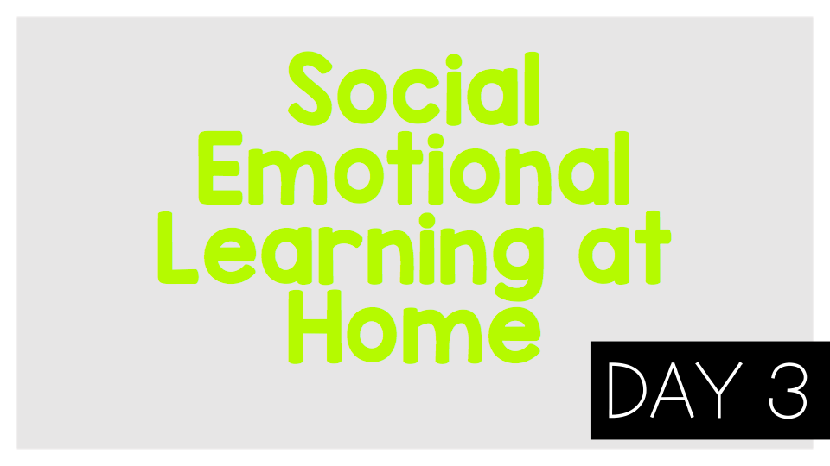
©TheSocialEmotionalTeacher

Slide 8
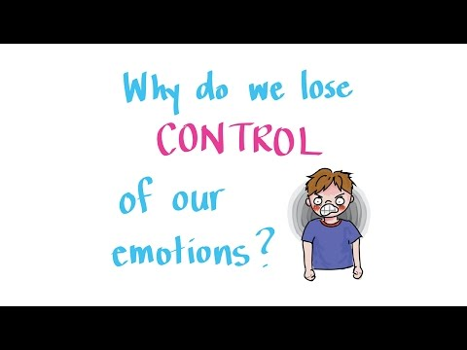
Think:
Have you ever gotten so mad that you turned a small problem into a big problem?
Have you felt sad or embarrassed after having a big reaction to a small problem?
What does it mean to “flip your lid”?
How do our brains work to keep us safe?
What can you do if you’re about to “flip your lid”?

Slide 9
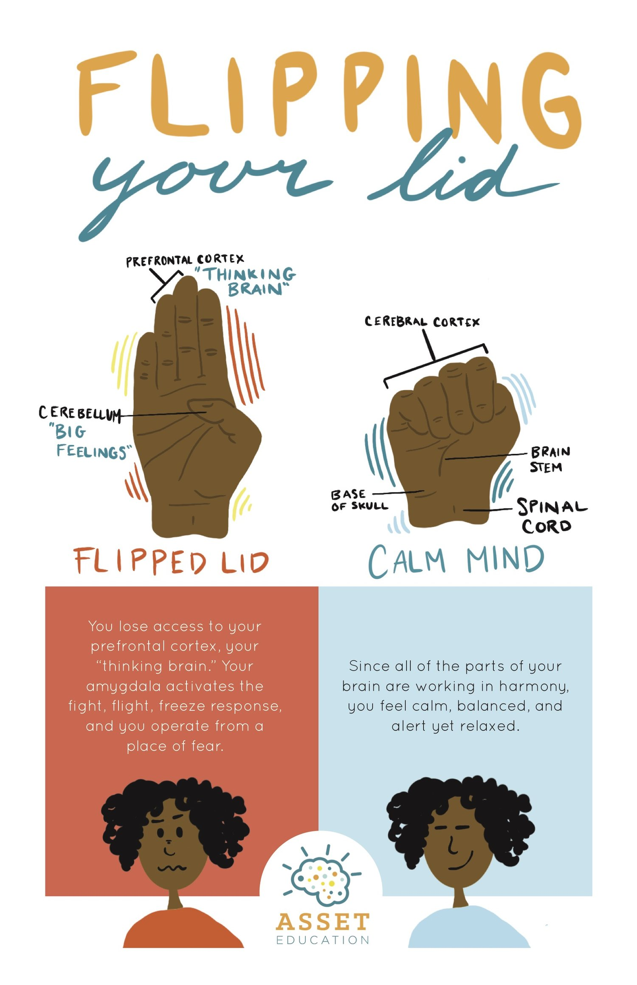
Activity:
Write about a time you “flipped your lid.” What happened? What could you have done differently to stay calm?

Slide 10
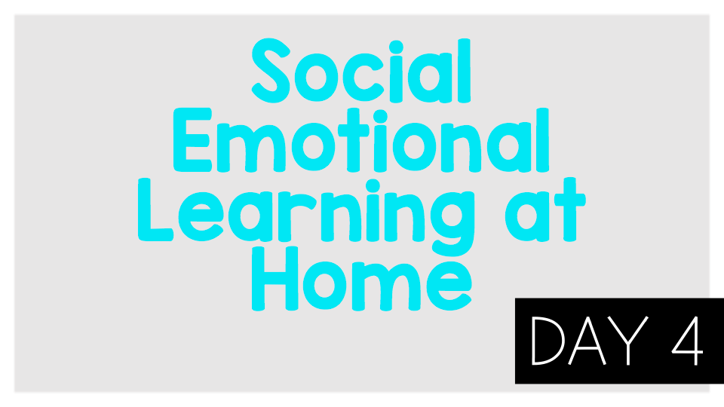
©TheSocialEmotionalTeacher

Slide 11

Think:
What are some of the worries Wilma Jean has? Can you relate to her worries?
What happens to Wilma Jean when she worries?
What did Wilma Jean’s teacher do to help Wilma Jean with her worrying?
Why is sorting our worries (like Wilma Jean’s teacher did) helpful?
Do:
Make a list of your worries.

Slide 12
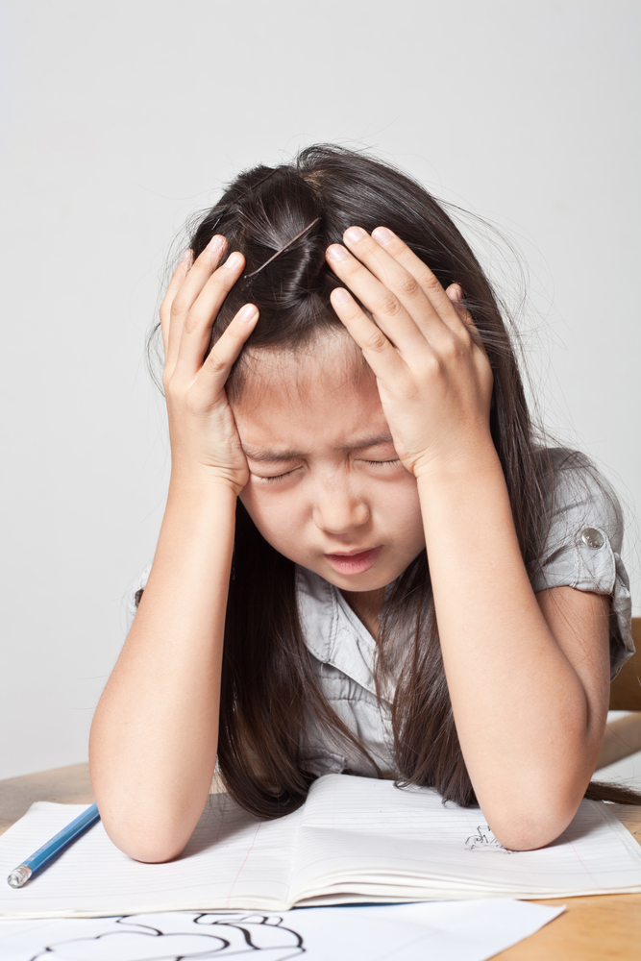
Activity:
Write about something you worry about. Why do you worry about it? How does it affect your life? Can you control it? What are some steps to take to help with this worry?

Slide 13
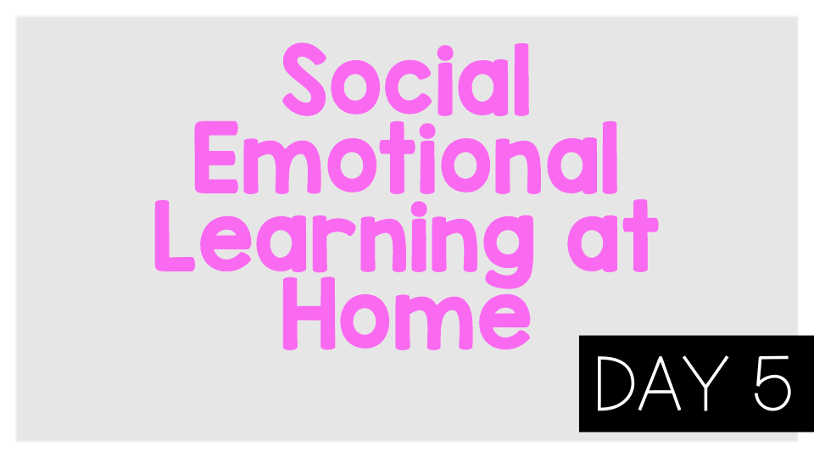
©TheSocialEmotionalTeacher

Slide 14
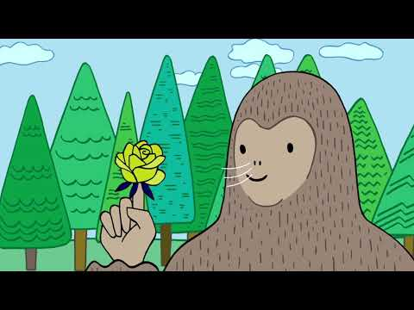
Mindful breathing is a strategy to help us manage our emotions. If we feel worried, sad, angry, overwhelmed, frustrated, etc. we can practice mindful breathing to calm down. Try it now by pressing play!
Think:
How do you feel after completing the mindful breathing?
How can this strategy help you in the future?

Slide 15
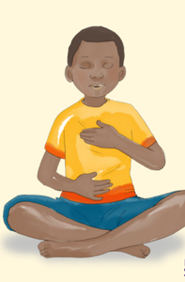
Activity:
Set a timer for 4 minutes. Think of ALL the things you feel worried about. Now practice one of the breathing exercises you learned in the video. How do you feel?

Slide 16

©TheSocialEmotionalTeacher

Slide 17
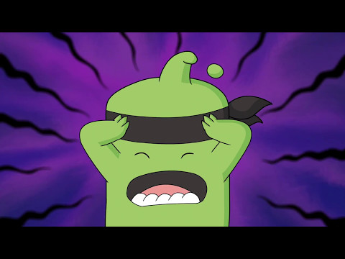
Think:
What is “the beast” in the video?
What made Mojo’s beast appear?
Think about a time you have experienced “the beast.”
Do:
Try the mindful breathing exercise on the next slide. Notice how you feel after.

Slide 18
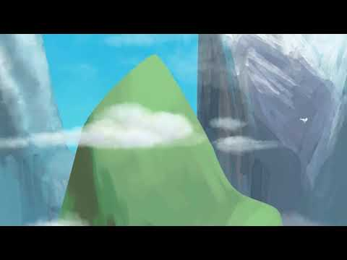

Slide 19
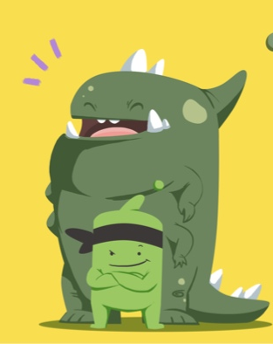
Activity:
Think about a time when your “beast” appeared. Write a letter to your beast about how he/she makes you feel and how you can conquer him/her.

Slide 20

©TheSocialEmotionalTeacher

Slide 21

Think:
How do you feel about making mistakes?
Were you ever afraid of something but you did it anyway? What made you try something scary?
Beatrice “felt her stomach jumping around inside her.” How do you think she is feeling? How do you know?
In your opinion, which is more important: learning from your mistakes or being perfect?

Slide 22
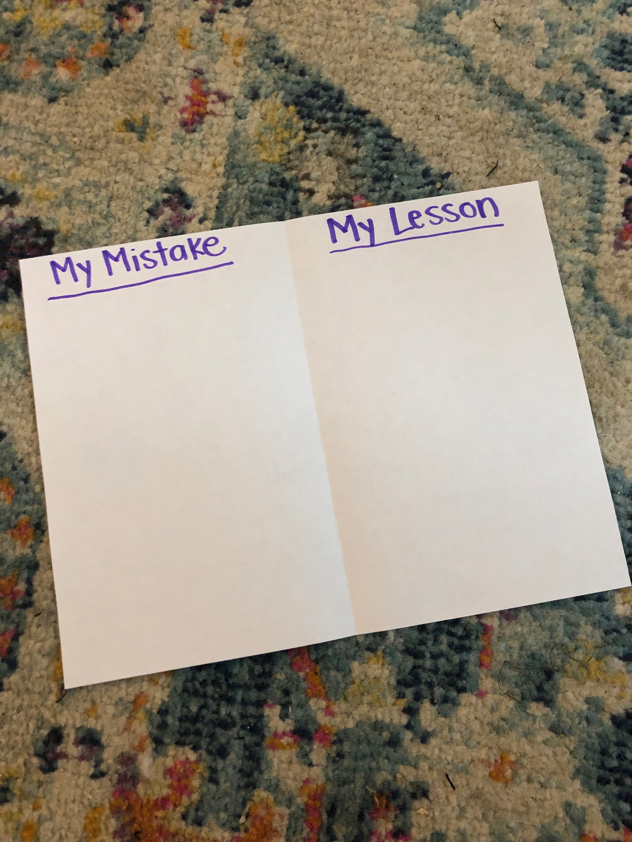
Activity:
Fold a piece of paper in half. On one side, write about a mistake you have made. On the other side, write the lesson you learned from your mistake.

Slide 23

©TheSocialEmotionalTeacher

Slide 24
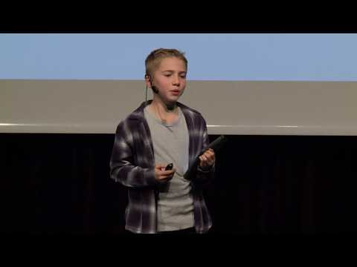
Think:
What is a growth mindset?
How did Michael Jordan have a growth mindset?
Why would coaches want someone with a growth mindset?
What is the difference between a growth mindset and a fixed mindset?
How did Carson, the 5th grader speaking in the video, use a growth mindset in reading?
How can you have the mindset of a champion?

Slide 25

Activity:
Write about something you can’t do YET, and come up with some steps to get closer to achieving it.

Slide 26

©TheSocialEmotionalTeacher

Slide 27
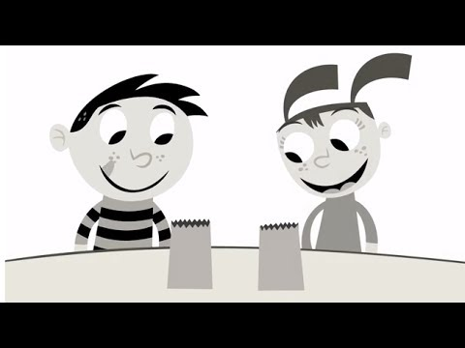
Think:
What do you see happening in the video?
What is happening to add color?
How can you color the world around you?

Slide 28
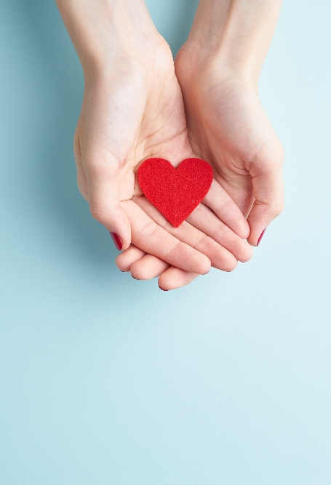
Activity:
Write a persuasive letter, convincing someone to help “color the world” by spreading kindness. Give at least 3 reasons why they should help.

Slide 29

©TheSocialEmotionalTeacher

Slide 30
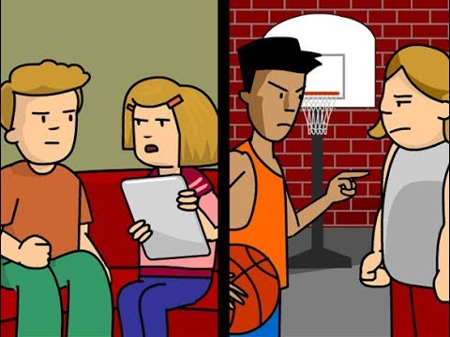
Think:
What is an example of a conflict from the video?
When have you felt angry or frustrated over a conflict?
Why is using anger or frustration not the best choice?
What is a strategy for calming down?
Why should you not ignore every conflict?

Slide 31
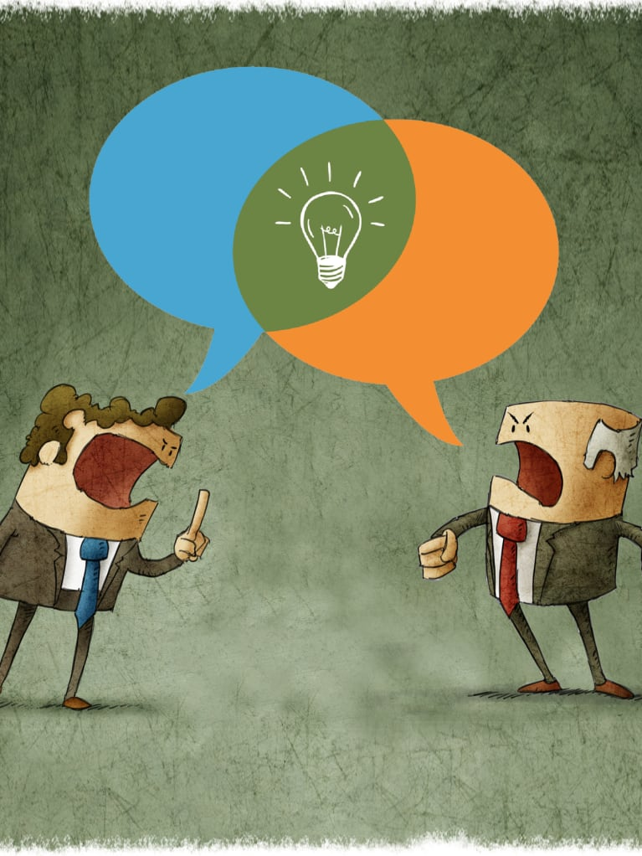
Activity:
Write about a time you had a conflict. What happened? How did you work to solve the problem? Would you do anything differently next time?

